Slide 1

Clearing a Path to Safety, Savings and Sustainability Using Less Salt
Notes:
Facilitator Notes – Before the meeting starts, test WIFI (if relying on YouTube for playing videos) and test audio.
Consider passing around or showing maps of the place you’re in as it relates to water resources (watershed maps, drainage maps, etc.)
Maps can be very engaging and connect people to the nearby water resources. People are often curious about where water flows to from where they live. This is a good ice breaker before the meeting starts.
Do introductions of facilitators and participants. Take some time to ask people what they love about where they live.
Describe the purpose of the program – to support facilities in smart winter maintenance by offering custom solutions to help people use less salt while maintaining safety where they live, work, worship, play, etc. Public winter maintenance providers, like cities, counties, and MnDOT have been working on reducing salt use for many years. A leading contributor of salt pollution in many watersheds comes from private properties. The purpose of this program is to help people learn about salt pollution and support people in using the right amount, at the right time, in the right place, to achieve their goals while using the least amount of chemicals necessary to get the job done.

Slide 2

Salt is a permanent, invisible pollutant
and it is being overused.
Notes:
Facilitator note – Consider referencing the pledge form. It has many potential actions and there will likely be some that could apply to this particular property.
There is no effective way to remove salt from freshwater.
Reverse osmosis is very expensive and not practical for cleaning up polluted waterways.
There also aren’t great alternatives to the salt on the market currently – they either have environmental, service, or cost tradeoffs.
The leading strategy for managing this type of pollution is to use only what is necessary to achieve the goal of safety and service to travelers and no more. If we are smart about what, when, and how salt is used, we can reduce the amount of salt that enters local waterbodies.

Slide 3

Salt pollutes our lakes and streams and harms aquatic species.
Notes:
Facilitator note – consider referencing local waterbodies by name, especially those participants have mentioned in the icebreaker or introduction.

Slide 4
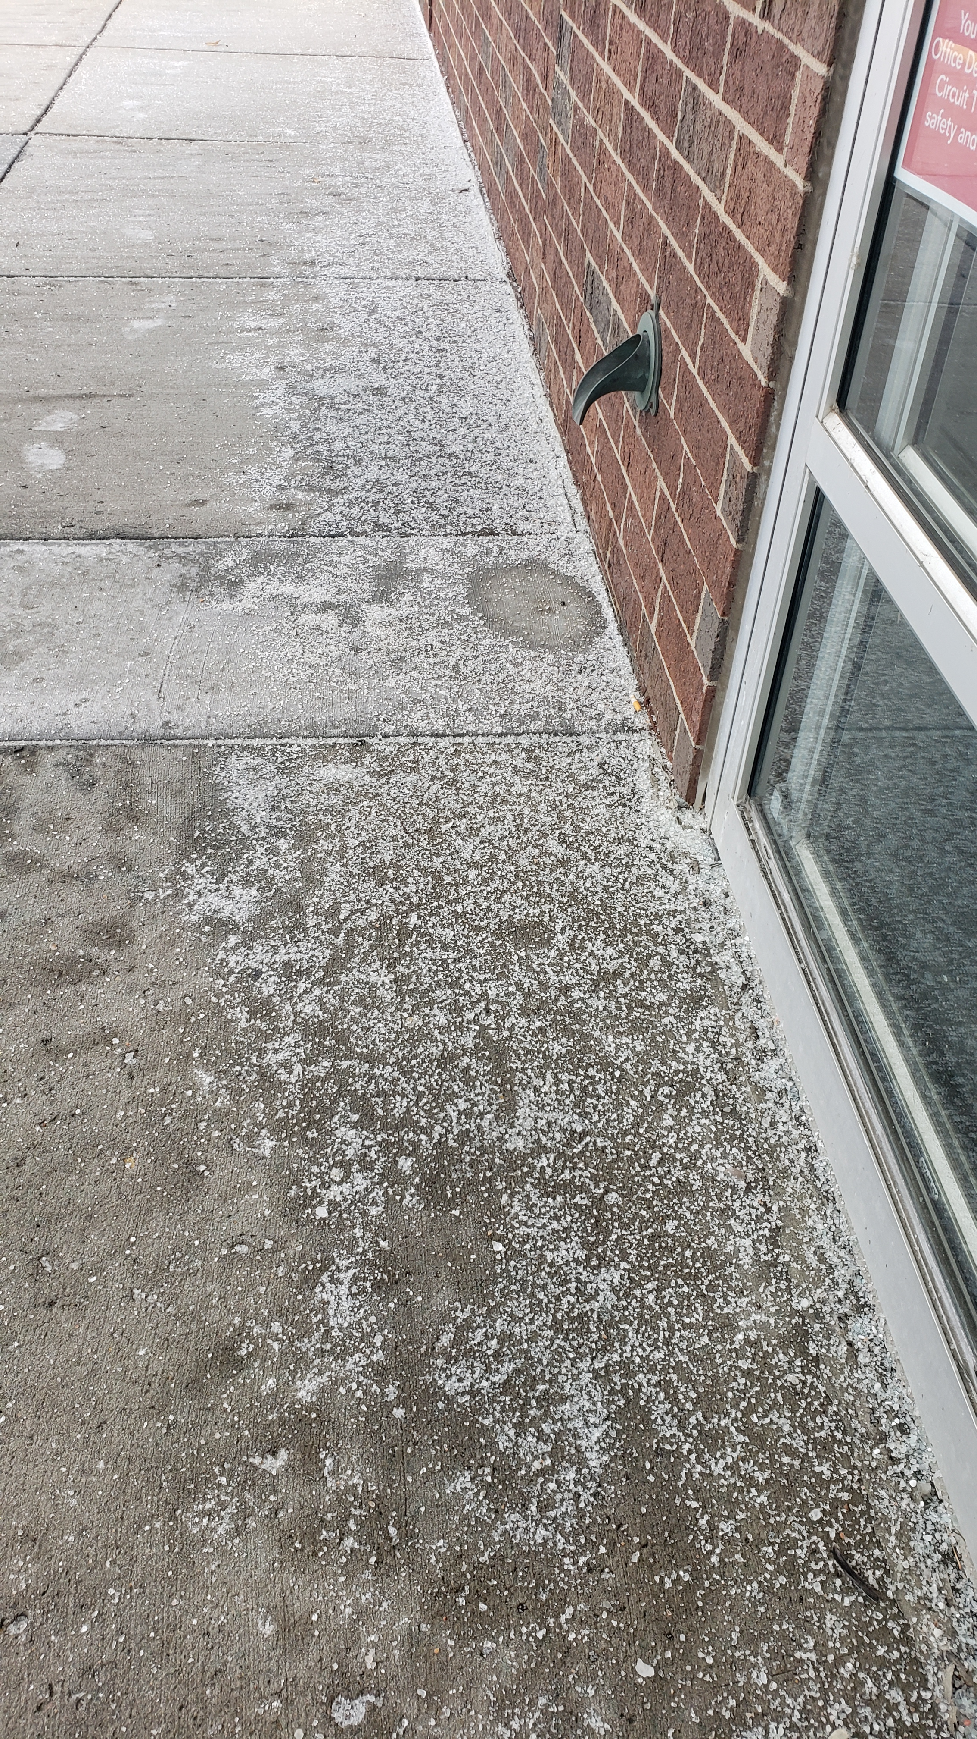
You can keep
community
members safe,
save money,
and preserve
the environment
while using
less salt.
Notes:
Facilitator note – Facilitators are here to help identify custom solutions and provide technical support.
Consider referencing the pledge form. It has many potential actions and there will likely be some that could apply to this particular property.

Slide 5








Advantages of Best Practices in Winter Maintenance
Efficiency
Costs
Documentation
Liability risk
Environmental quality
Infrastructure damage
Public safety

Slide 6
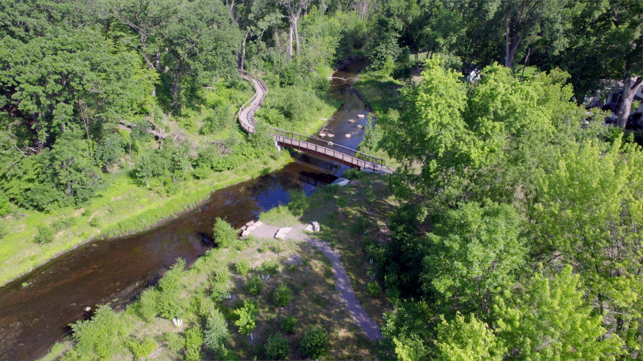
Low Salt, No Salt Minnesota
Video (4min 45 sec) https://www.youtube.com/watch?v=IN28xSzYv94
Notes:
PLAY VIDEO ( 4.45 MINUTES )
Facilitator note – Play the video from Youtube if an internet connection is available. Otherwise, consider downloading the video. Search how to download videos from Youtube for guidance.

Slide 7
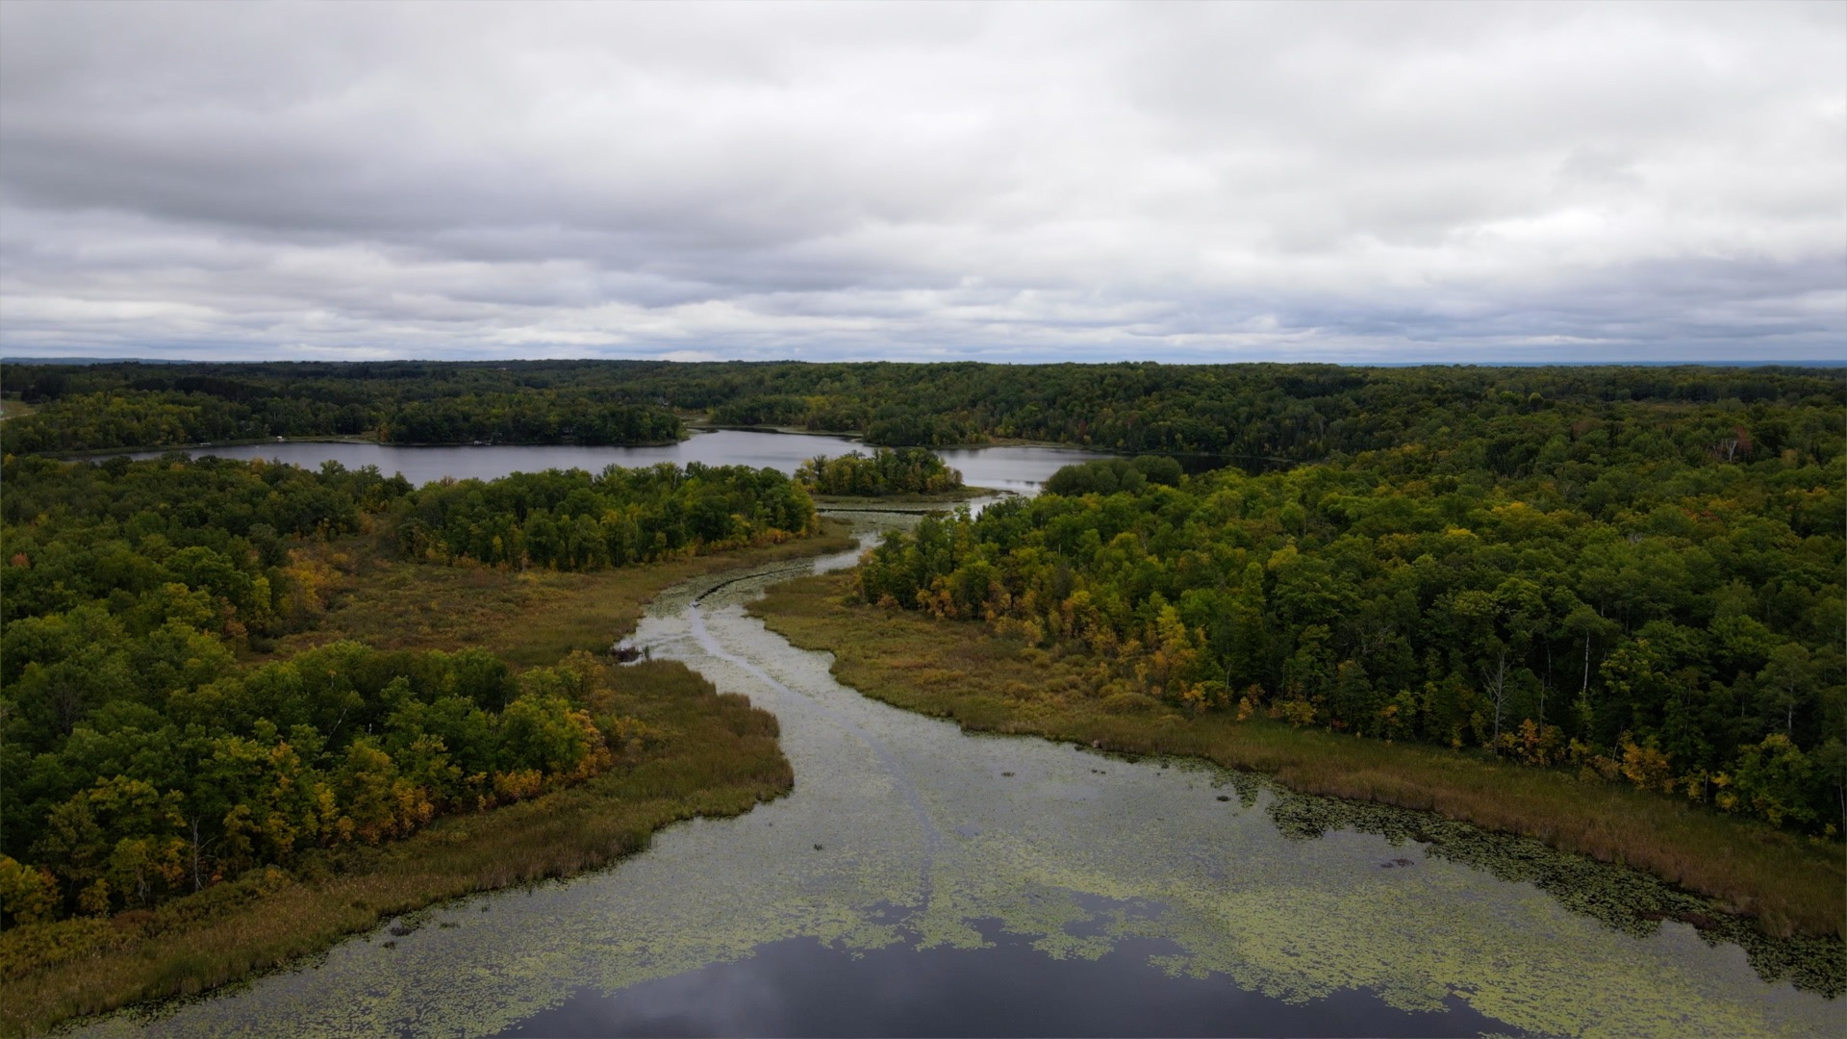
Harmful effects of winter maintenance salt
Salt pollutes natural water sources, like lakes
and streams, and drinking water
Salt harms lawns and landscaping, concrete and
asphalt, carpets and floors, vehicles, shoes, and
pets
Salt is expensive in terms of materials and labor
Notes:
Facilitator note – if showing the video during the presentation, consider removing or hiding this slide. Follow the same steps to ‘unhide’. If sharing a PDF of the slides after the meeting, consider unhiding and including in the PDF.
To hide a slide, right click on the slide in the table of contents and select ‘Hide Slide’.

Slide 8
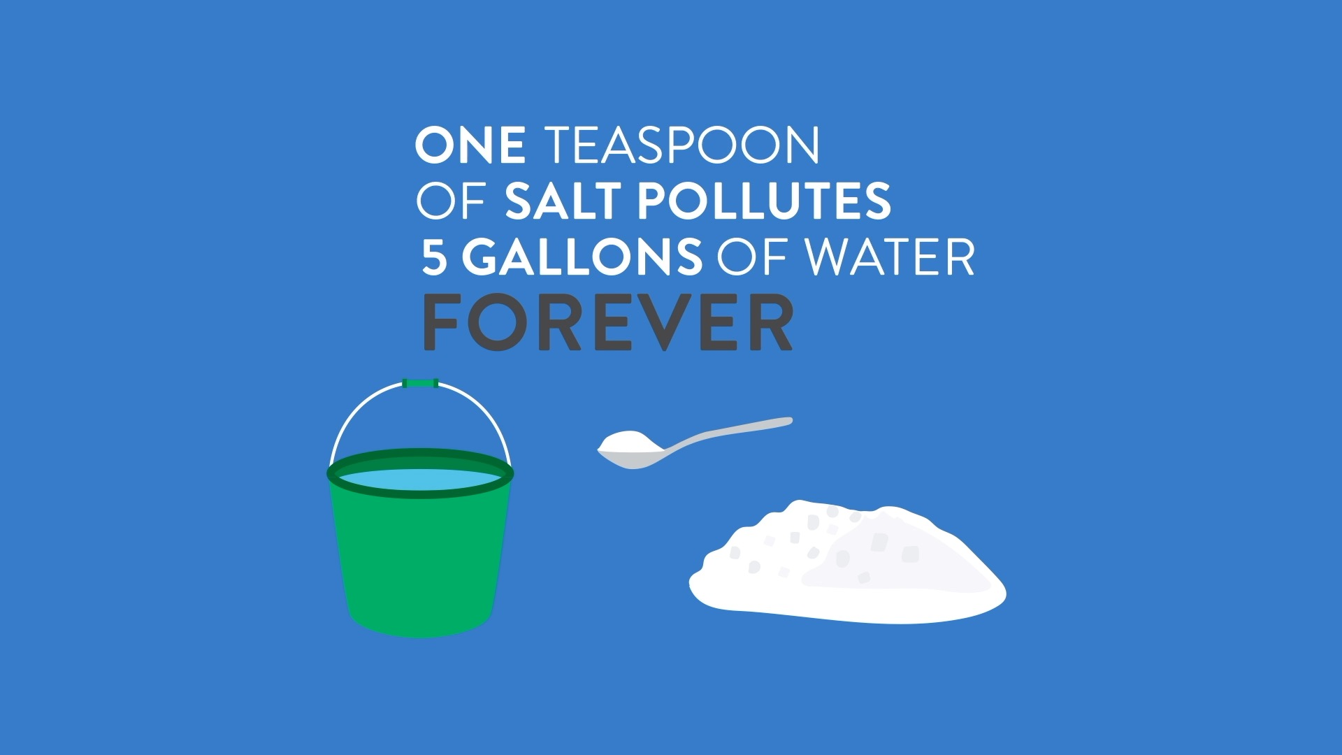
Notes:
Facilitator note – after viewing the video, pause here to check in with your audience.
What was surprising? What did you already know? What stood out to you about the video?
Does this video reflect your experience of winter in Minnesota?

Slide 9
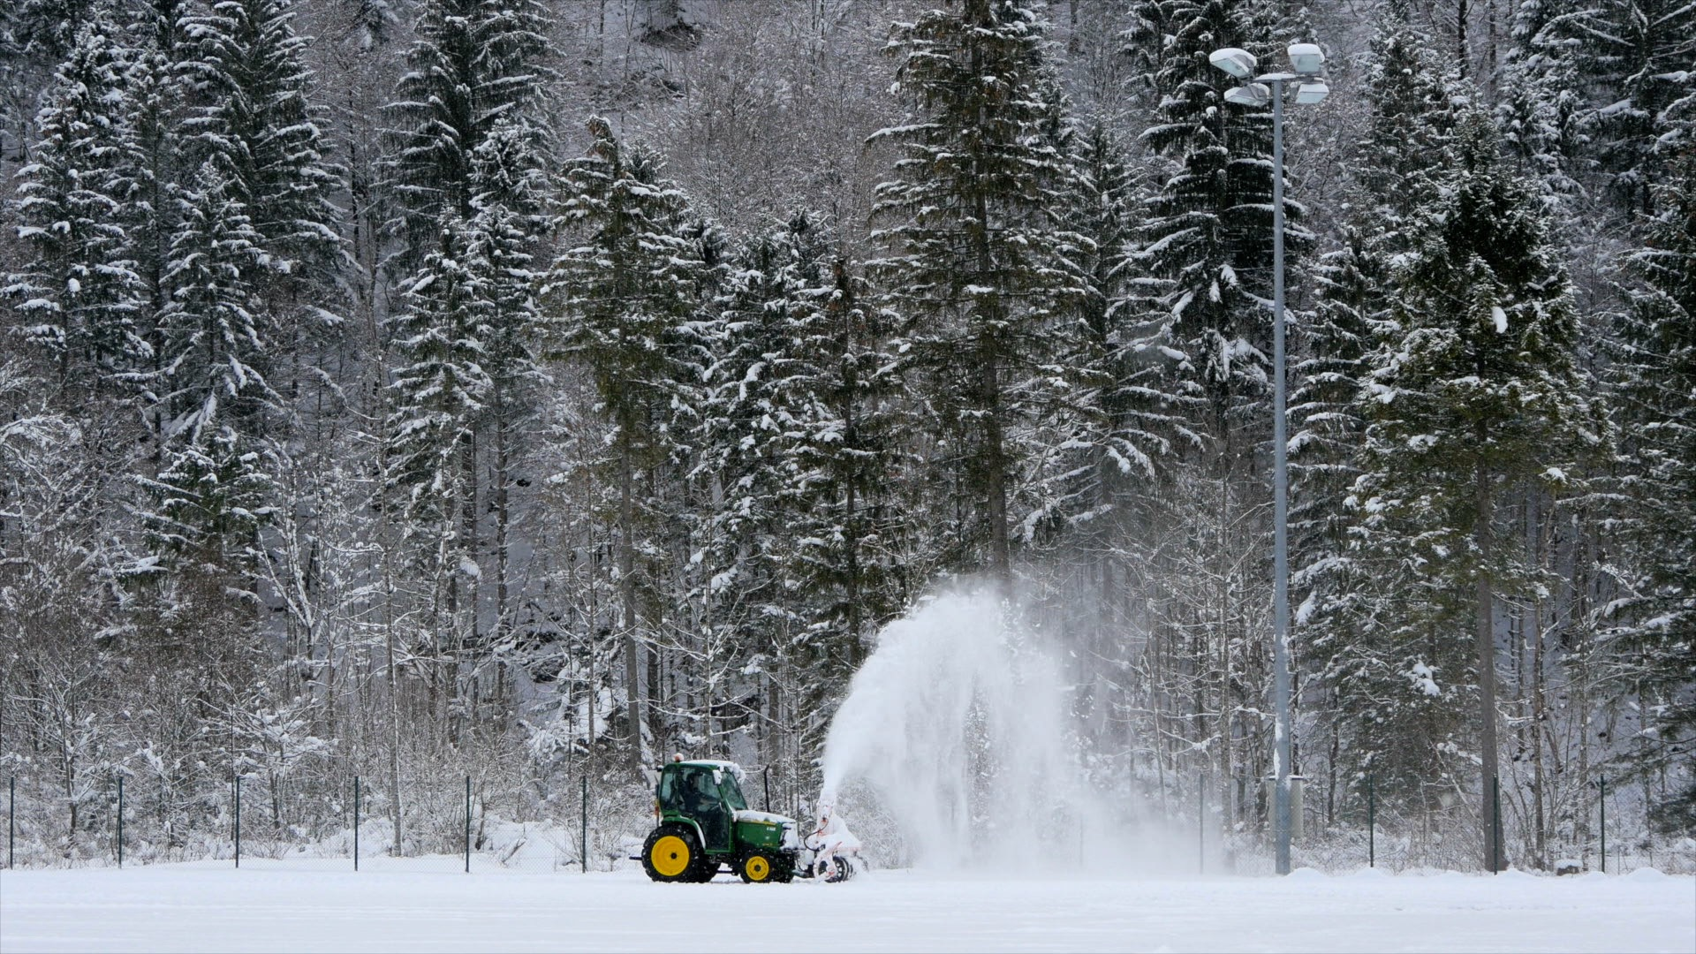
Good News!
Salt reduction best practices
are well-established in Minnesota
and do not compromise safety.
Free or low-cost help with best practices is available
from your city, watershed district, and the Minnesota Pollution Control Agency.
Notes:
Facilitator note – if showing the video during the presentation, consider removing or hiding this slide. Follow the same steps to ‘unhide’. If sharing a PDF of the slides after the meeting, consider unhiding and including in the PDF.
To hide a slide, right click on the slide in the table of contents and select ‘Hide Slide’.

Slide 10

“Three years ago, if you had told me that I could reduce salt and increase safety, I wouldn’t have believed it,”
- Nick Queensland, ground maintenance supervisor,
Mayo Clinic, Rochester
Notes:
Facilitator note – There is good news. Salt reduction best practices are well-established in Minnesota and do not compromise safety. We’re here to help you identify solutions to fit your space. Others have adopted low salt no salt winter maintenance strategies with success.

Slide 11
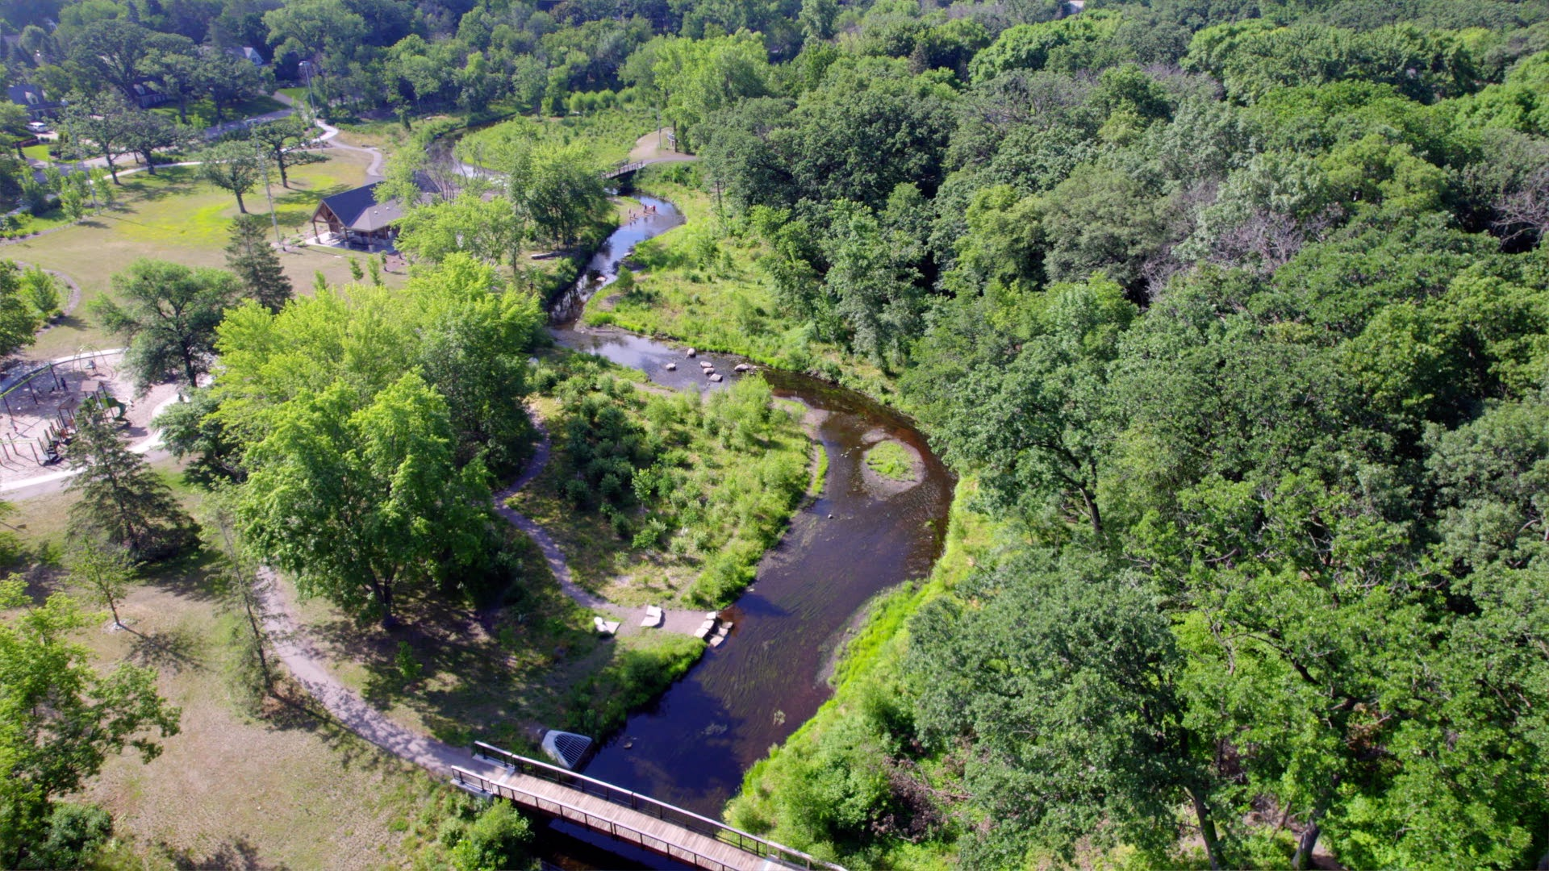
“It’s better for the environment,
it saves the association money,
and saves on repairs in the long run.
It’s a plus all the way around for us.”
– Condo/townhome association board member

Slide 12
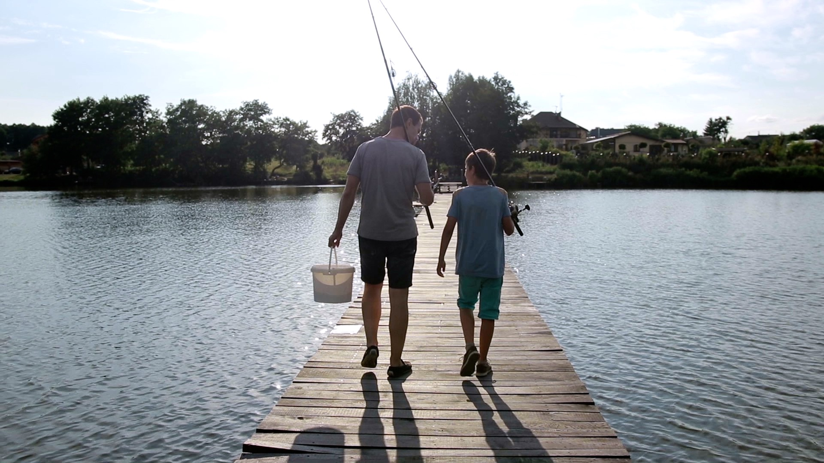
“It’s a good story: cleaner environment
and less costly.”
- Condo/townhome association board member

Slide 13
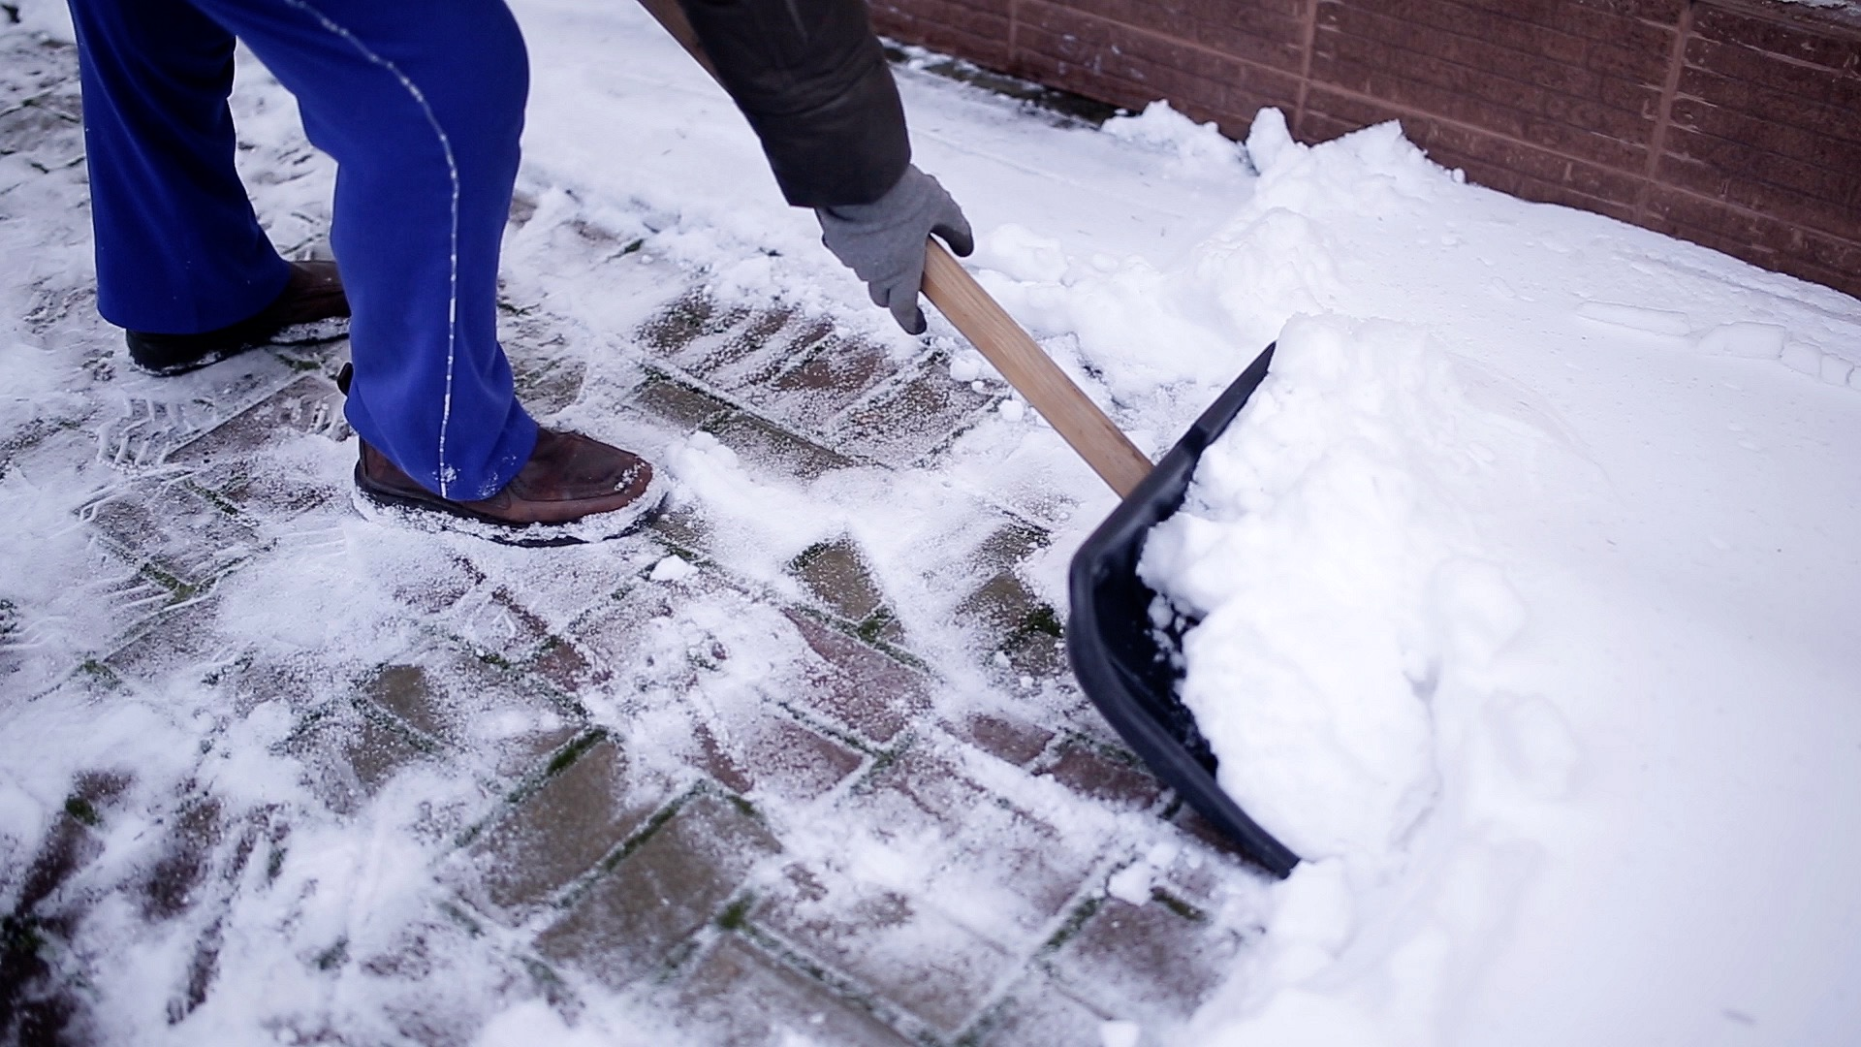
Be Smart about Salt Use:
Shovel
Select
Scatter
Sweep
“Effective and timely snow removal
reduces the need for salt use.”
– E.J. Hook, Montana State University
Notes:
Facilitator note – So, how can you reduce chloride at your facility? These strategies can help ensure the right product is used at the right time and in the right amount to get the job done while maintaining safety and service for travelers.
Quality of mechanical removal, pavement temperature, individual deicer capacity and melt speed, along with weather conditions and expected future conditions are all factors that determine deicer use.

Slide 14
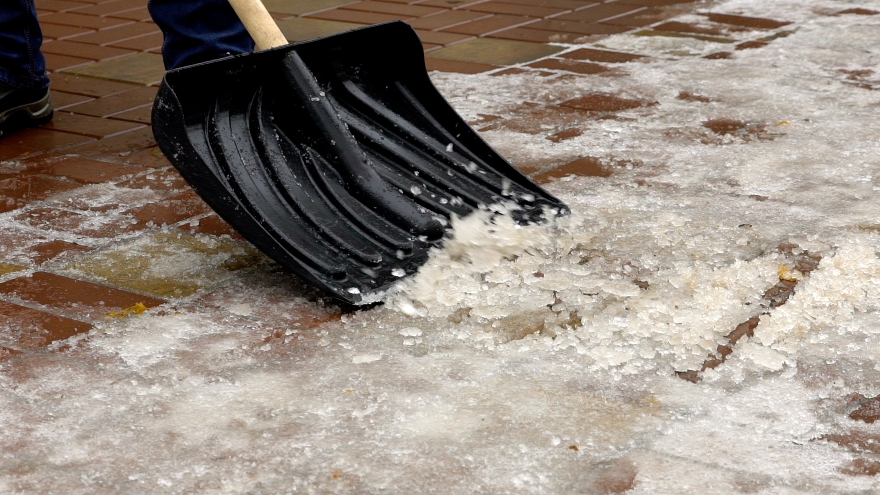
Shovel
Your goal is not to melt everything
Your goal is to apply
just enough to allow for mechanical removal
of snow and ice.
Watch the weather
Clear walkways and roads before snow turns to ice
Apply salt only if needed
Notes:
Facilitator note – The more snow and ice you remove manually, the less salt you will have to use and the more effective it can be.
Whether you use a shovel, snow blower, snow plow, or ice scraper, get out there as early as you can and keep up with the storm. You may even decide that salt isn’t needed.
Rock salt may be used to loosen snow and ice so that it may be physically removed by shoveling or plowing.
Rock salt should not be used as a pre‐ treatment in anticipation of snow. If it is, it often gets plowed or shoveled off into green spaces or piled up at the edge of a parking lot where it doesn’t do any good, and in fact, only stays until meltwater carries it into local lakes, streams, and/or groundwater.
The best course is to promptly shovel and plow to reduce snow and ice build‐up.

Slide 15
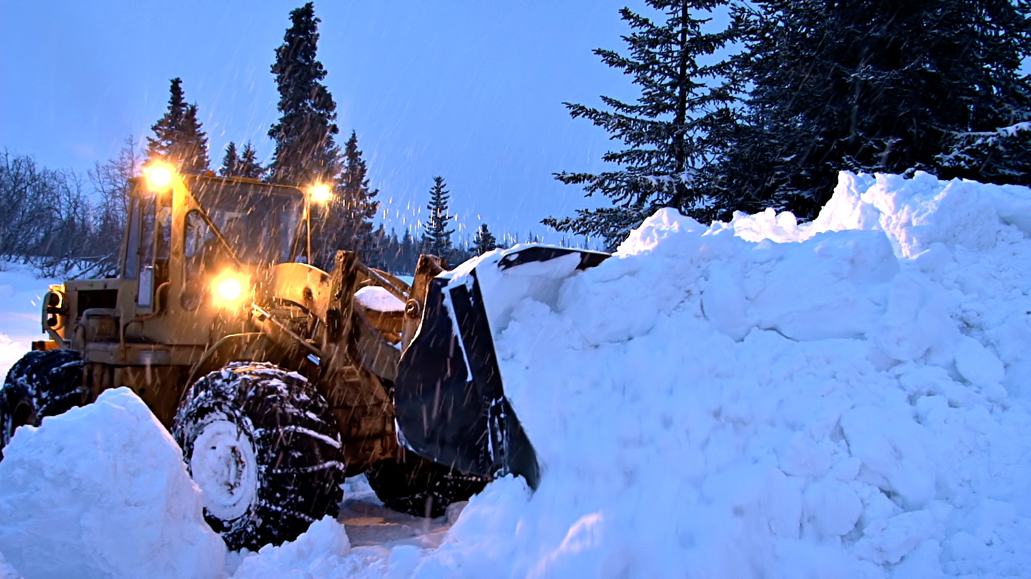
Select
Choose the right product for
the conditions
Typical de-icing salt doesn’t melt ice
below 15° F
Use sand for traction when it’s
colder, or use a different de-icer
Notes:
Facilitator note – The melting effect of salt also slows as the temperature drops.
Adding more salt doesn’t help it to melt any faster. Be patient.
Read the product label to determine if applying the chemical will work given the temperature.
Sand may be used for traction, though it doesn’t melt ice.
Ask people what other materials they’ve used for traction. What have they tried? Has it worked for them?
Sand and kitty litter are common responses.
Consider offering to help read product labels after the meeting or during an optional walk around the building and grounds.

Slide 16
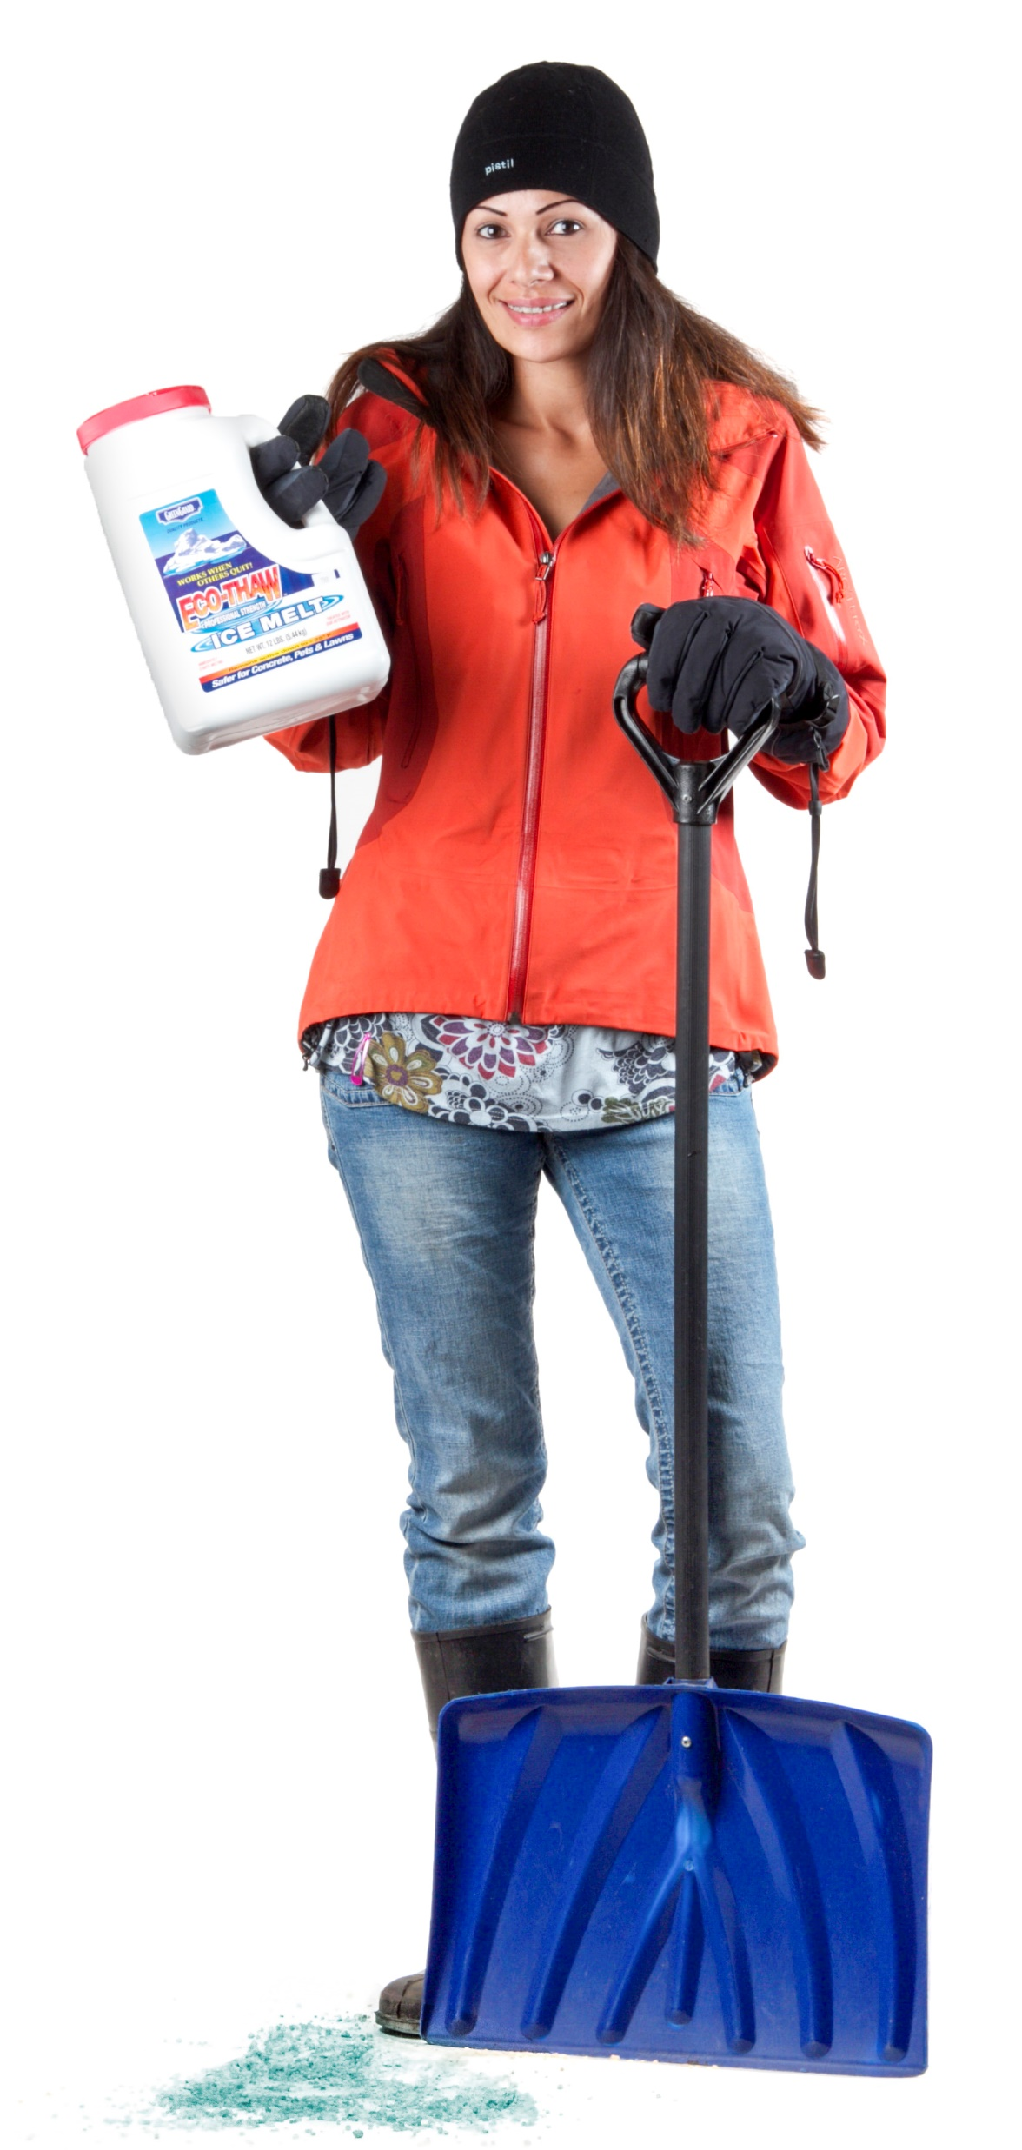
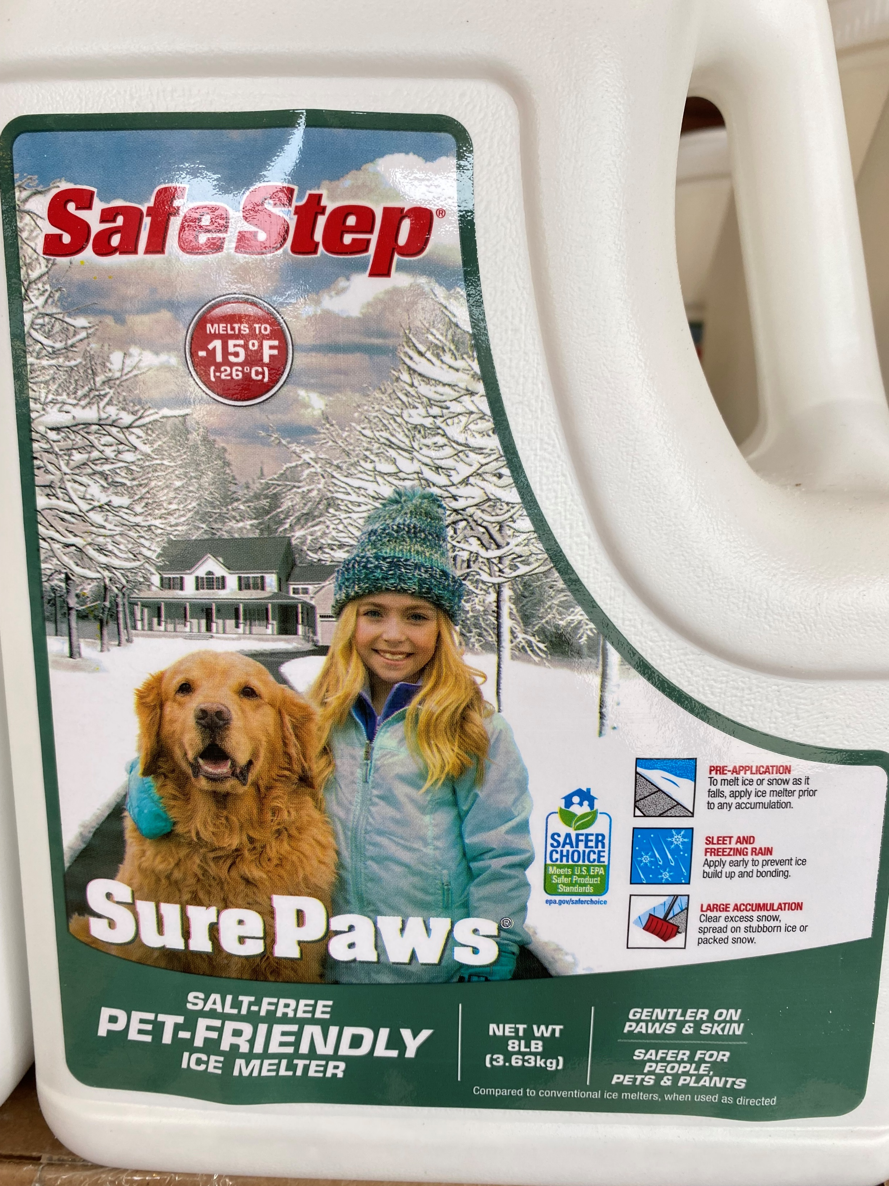
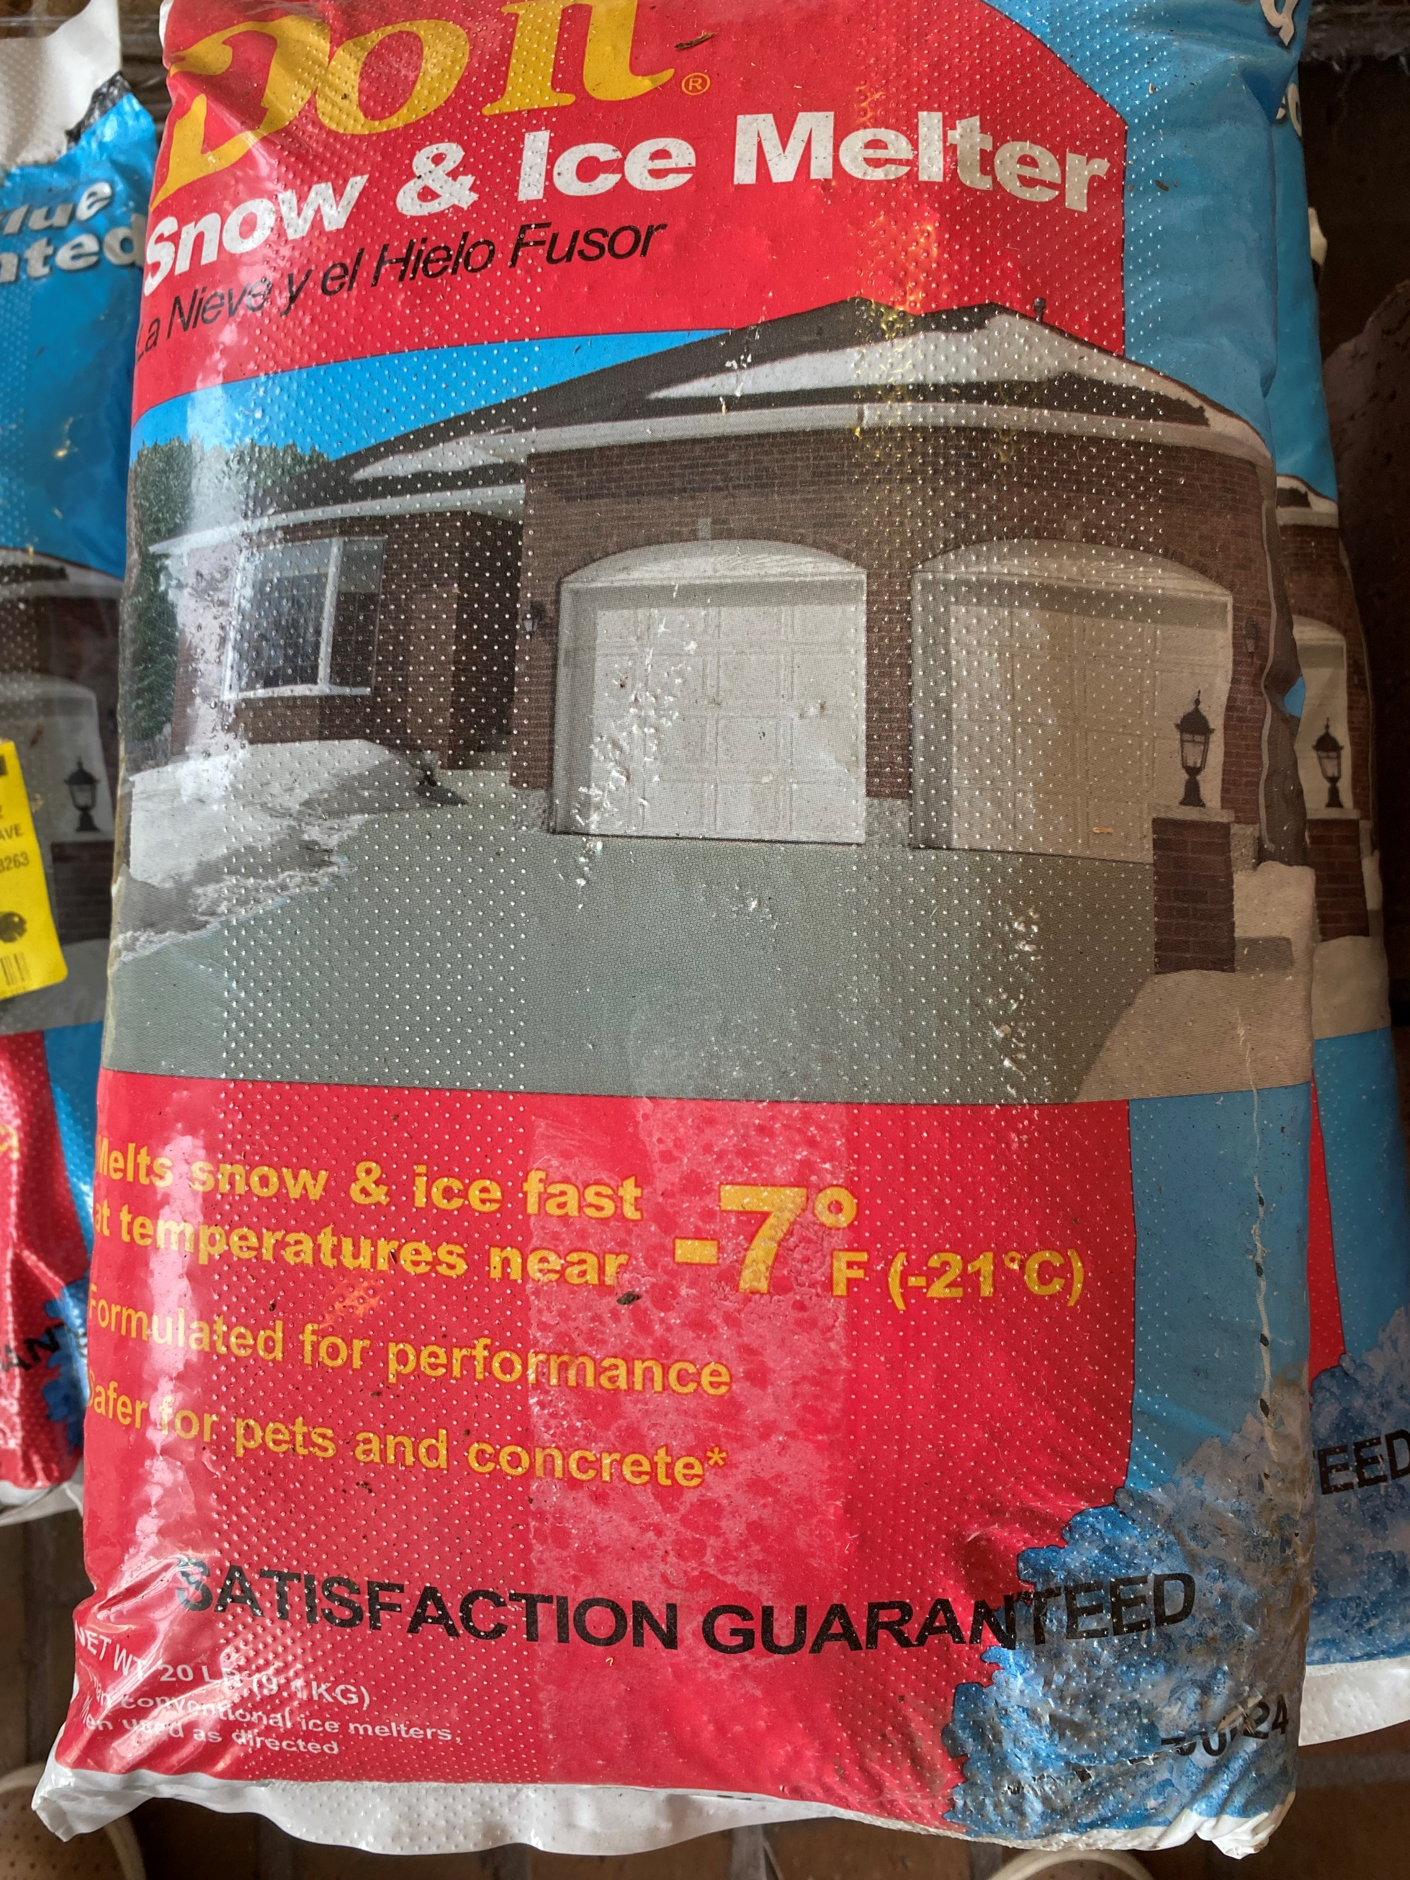
Buyer Beware
Unregulated Labels and False Claims
Notes:
PRESENTER NOTES - Set the context for selecting deicers:
There is no truth in advertising for this product category of deicers like there is for many other consumer products. Don’t assume what you see on a package is true. No regulation means packages can say and contain anything. Often there is no list of ingredients and misleading product names. No regulation mean no scientific standards that support the claims.
There are many, many products and making an informed decision in this category is very difficult for a casual user. Effectiveness and speed of deicers is based on chemistry of deicing ingredients in a package in combination with pavement temps, weather, and form - liquid or granular.
Trained professionals who work on and know your property well and with whom you have had meaningful conversations about your values and wishes for care of your property and our world.
However, we understand there are times that casual users need deicing products. We can’t tell you for sure about products since there is no truth in labeling, however there are a few good practices we recommend:
1. Shovel first, and then evaluate if you need to do more. Don’t assume salt or sand is needed.
2. On a warm day, if you need melting use an inexpensive deicer. A very effective and economical is sodium chloride. No other ingredients needed!
3. On a cold day, use a more expensive product. Generally, more expensive products are blends of several deicers. There is no guarantee it will work, but your chances are increased on a cold day.
4. On a super cold day, use an abrasive (sand or grit). No deicers.
5. For any deicer to melt ice, place it on top of ice, - not on snow (forms slush) or bare pavement (does nothing except waste you money).
6. It’s hard to be perfect with amount applied. Use the patterns we’ve already discussed. Sweep up leftover deicer after a day and reuse.
Conclusion:
We can’t tell you for sure about products since there is no truth in labeling, but you have a reasonable chance by basing your choice on price.
There are no laws or rules for labeling chloride alternative products and many times the ingredients are not listed. Even if labeled “environmentally friendly,” chances are good that it’s not.
We have a handout from MWMO that you might find helpful.

Slide 17
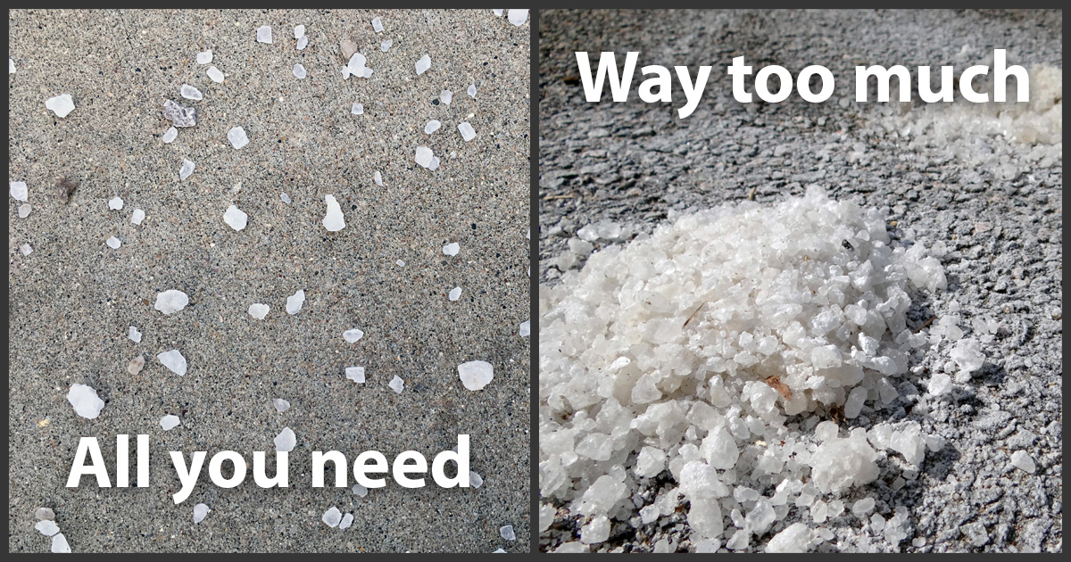
Scatter
Aim for 3ʺ of space
between salt granules
Use salt only where critical
Notes:
Facilitator note – Deicer used on bare sidewalks have nothing to melt.
People often apply way too much salt. More salt doesn’t mean more melting.
A typical‐size parking stall requires only about a 2/3 coffee mug scoop worth of salt.
Rock salt should not be used to pre‐treat areas in anticipation of snow and ice. Instead, it should be used just enough to loosen snow and ice so that it can be shoveled or plowed away.
If there are areas that are continually problems, consider talking with an expert about how to solve the ice issue – there may be grading or drainage problems that can be addressed during the spring or summer.
Local authorities can offer initial ideas and advise on any necessary permits.

Slide 18
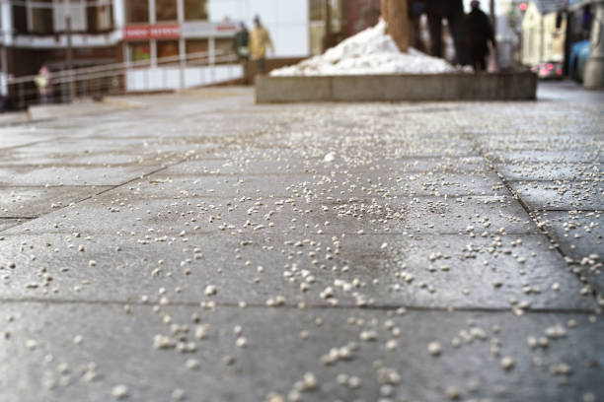
Sweep
Clean up leftover salt, sand, and de-icer
Save and reuse as needed
Notes:
Facilitator note ‐ Any leftover salt after the snow and ice is gone is no longer doing any work and should be swept of and disposed of properly. Swept up salt can be reused or can be disposed of in regular trash (facilitators may wish to check on local regulations/options for disposal).
If piles of salt are observed in clear and dry streets, you can typically contact your local authority to have it cleaned up (facilitators may add additional location‐specific details on how to make this request).

Slide 19
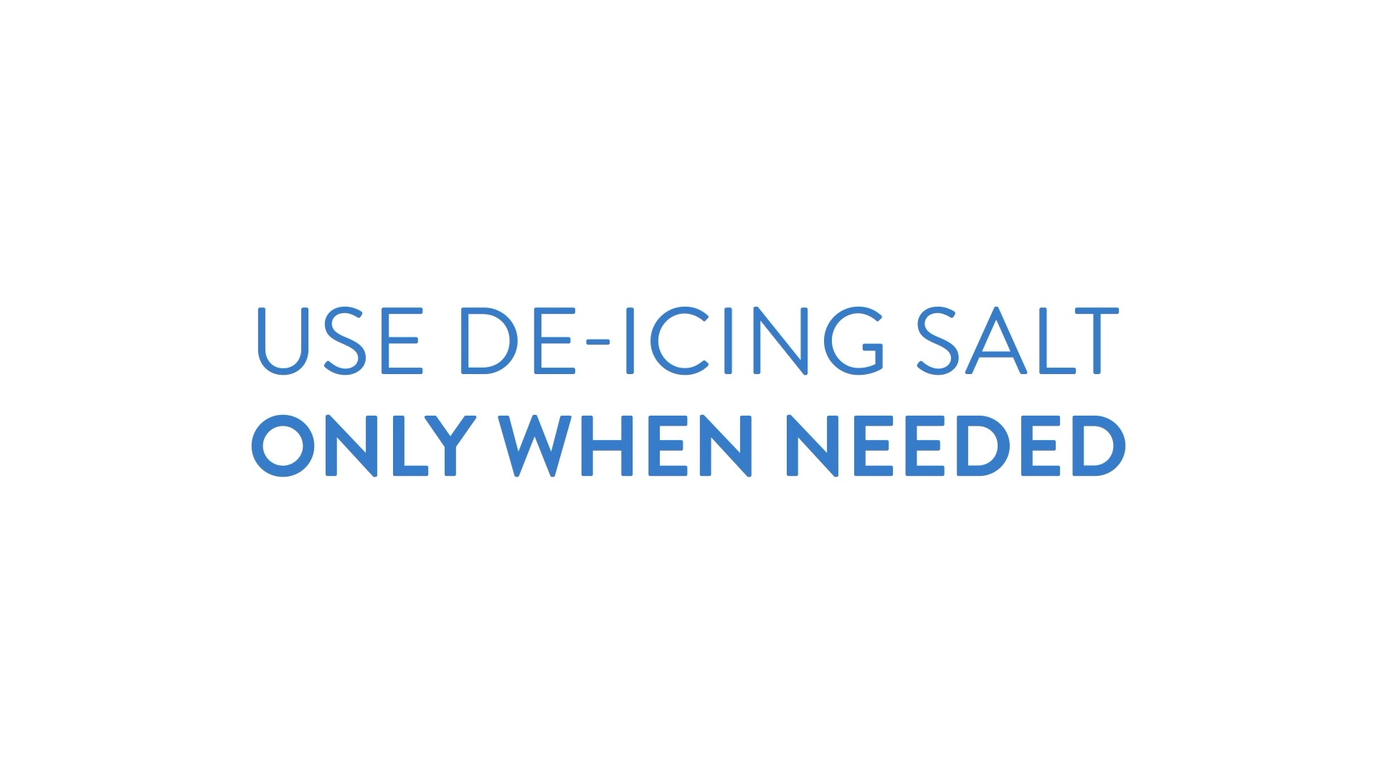

Slide 20
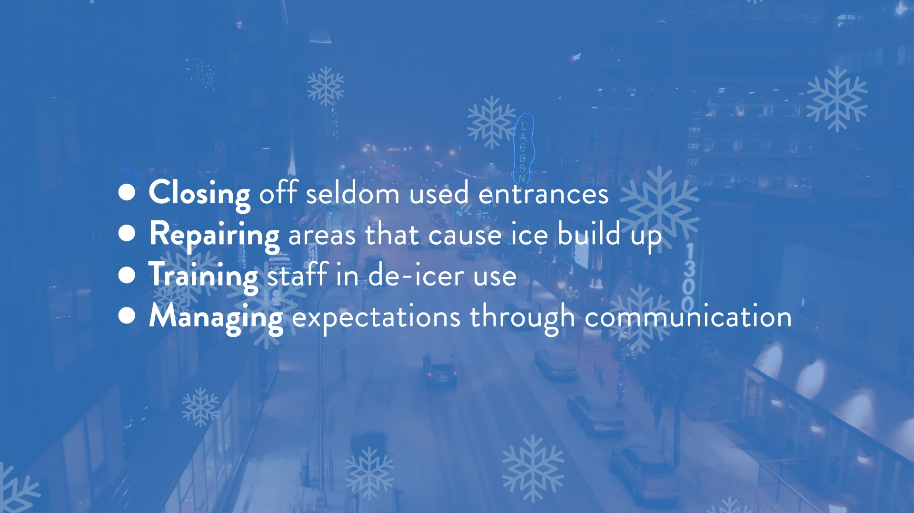
Best Winter Maintenance Practices
Notes:
Facilitator note – if showing the video during the presentation, consider removing or hiding this slide. Follow the same steps to ‘unhide’. If sharing a PDF of the slides after the meeting, consider unhiding and including in the PDF.

Slide 21
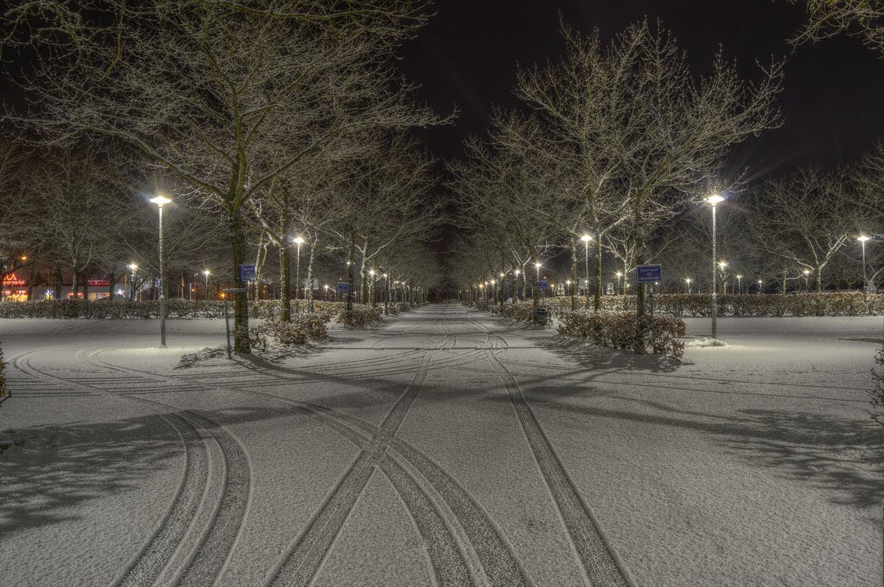
Additional best practices
Get Smart Salting training for yourself
and/or hire trained contractors
Available through the Minnesota Pollution Control Agency
Notes:
Facilitator note – Ask the audience if they do the winter maintenance themselves, if they have a central maintenance person who is responsible, or if they hire out that work.
Ask if that person has been trained or if someone in the room would be willing to find out.
Offer to connect people to training, review contracts, check the list of winter maintenance professionals who have received training, share a model contract that might be adapted for this audience, etc.
Consider referencing the pledge form.

Slide 22
Write, implement, and communicate your winter maintenance plan
Tell folks why things will look different, what to expect
Templates available through your Low Salt, No Salt Minnesota ambassador or the MPCA

Slide 23
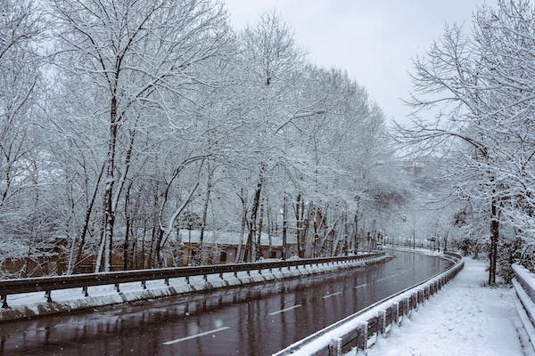
Prepare for winter
Sites and circumstances differ
Work with us to find the best solutions customized
for your site
Many of you are already doing a lot to ensure effective
low salt, no salt winter maintenance
We learn from you – please share your ideas

Slide 24
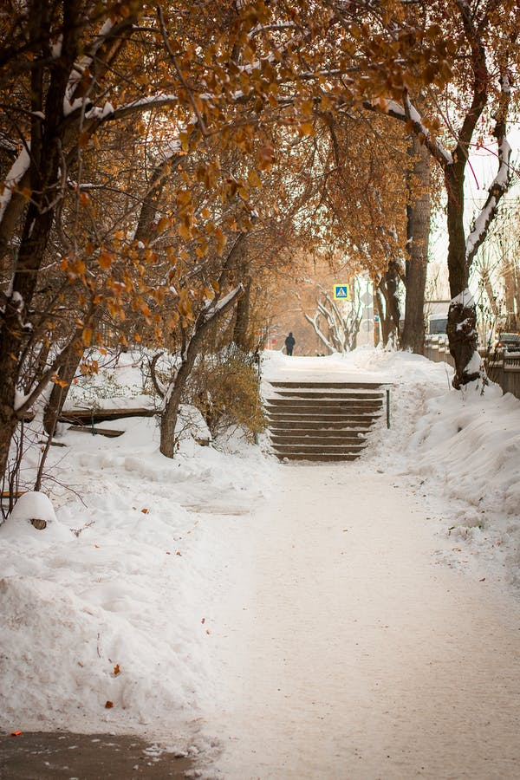
What areas of your buildings and grounds require winter maintenance activities?
What are the challenging or problematic
areas of your site?

Slide 25

What types of winter-related injuries, if any, do you have?
Where do they occur?

Slide 26
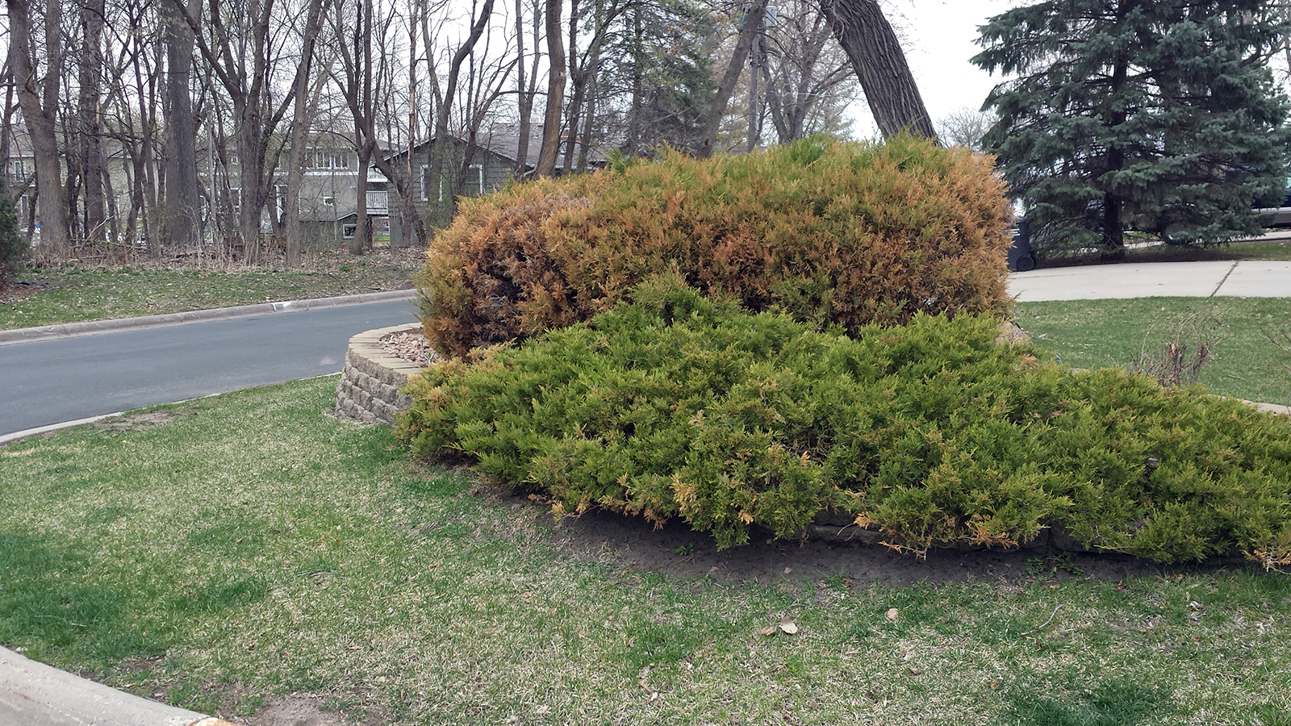
What natural resources, landscaping features, and other amenities are at your site?
How will you protect them from salt damage?

Slide 27
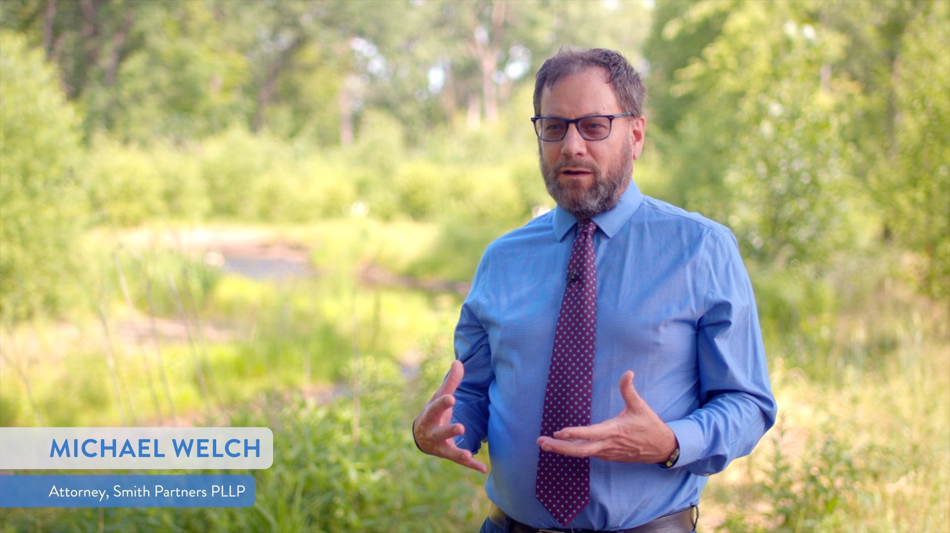
A word about liability
Everyone’s top concern is for safety,
but liability is also a worry
Training in best practices, and
solid documentation on the use of
these practices are important to
be able to demonstrate “due care”
in winter maintenance*
*Not a substitute for advice from your attorney.
Seek legal counsel regarding your site and circumstances.

Slide 28
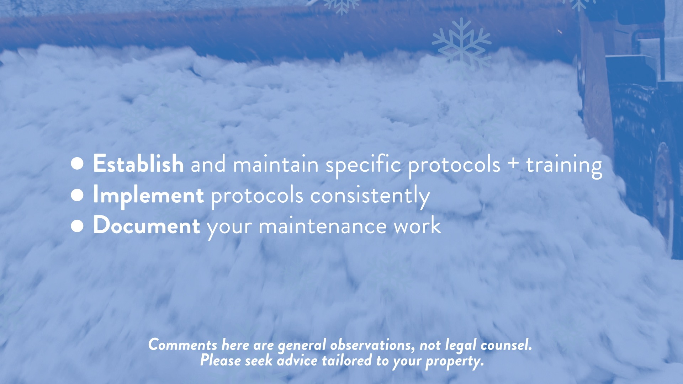
Liability and Winter Maintenance Planning
Video (2 min 45 sec) https://www.youtube.com/watch?v=IoOHw_EY6T0
Notes:
PLAY VIDEO (2:33 MINUTES)
Facilitator note – Play the video from Youtube if an internet connection is available. Otherwise, consider downloading the video. Search how to download videos from Youtube for guidance.

Slide 29

With Low Salt, No Salt Minnesota,
you can keep your community members safe
while using less salt.

Slide 30
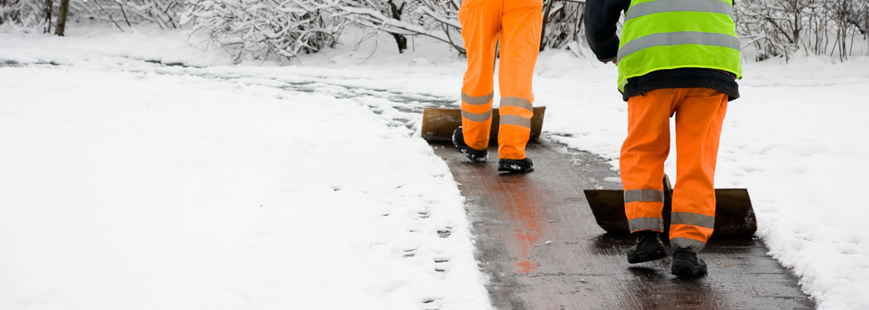
Stay safe while using less salt.
Salt reduction best practices
are well-established in Minnesota
and do not compromise safety.
You can confidently and safely prevent slips and falls
while using less salt
Shoveling and sweeping are more effective than salt
at preventing icy sidewalks and roads/parking lots
Salt doesn’t melt ice when temperatures reach
15°F or colder
Notes:
Facilitator note – make reference to specific safety concerns or issue areas you’ve heard from this audience. Offer ideas (and reference the pledge form) that suit this audience.

Slide 31
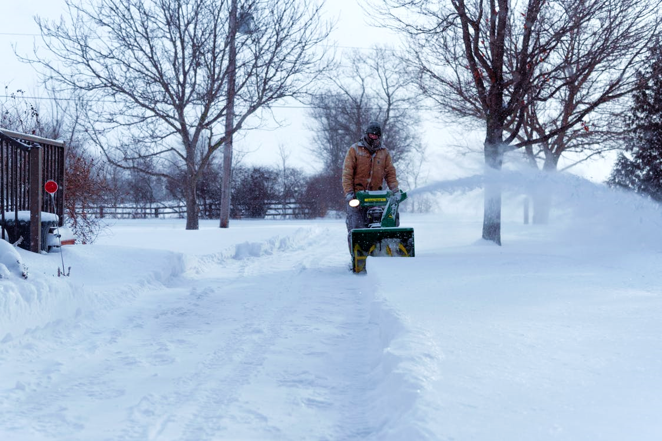
Save money by using less salt.
You can confidently and safely cut
winter maintenance costs using
low salt, no salt solutions
More salt does not mean more melting,
so use less salt and save money
Sweep up excess salt for reuse, before it
washes into our waterways
Using less salt reduces costly damages
to landscaping, flooring, and hard surfaces
Notes:
Facilitator note – make reference to specific maintenance or affordability concerns you’ve heard from this audience. Are there any places where they’ve noted salt damage? Offer ideas (and reference the pledge form) that suit this audience.

Slide 32
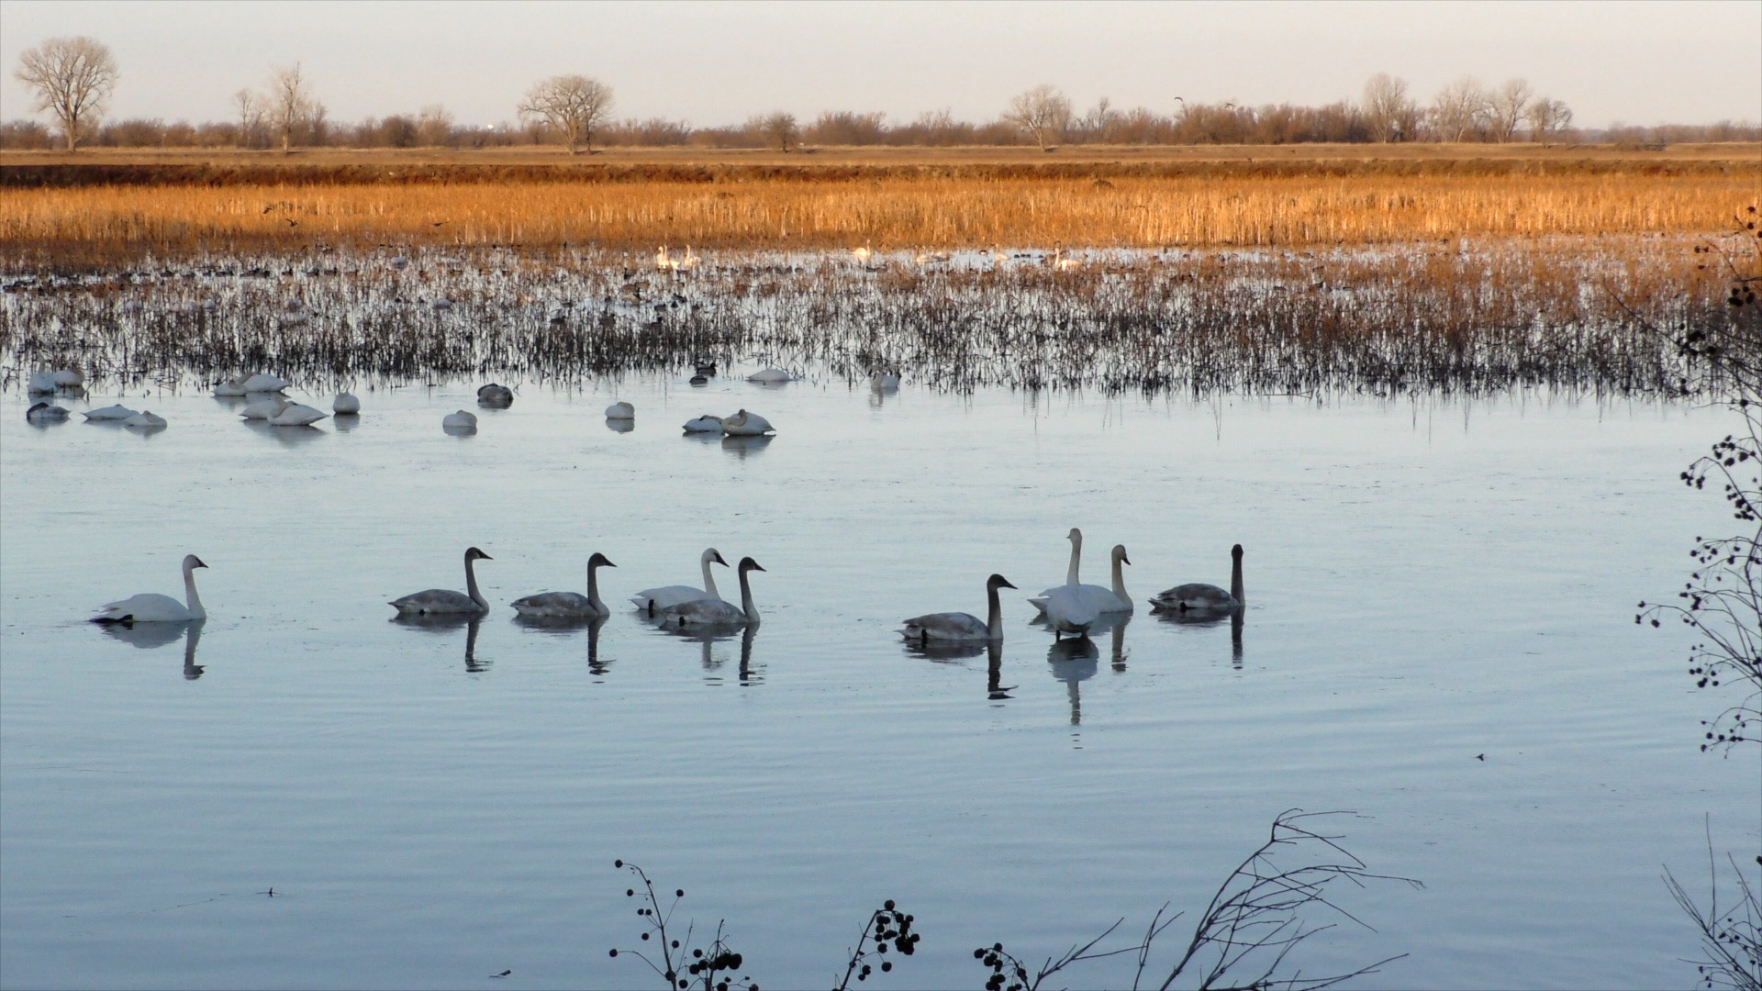

Preserve Minnesota’s lakes and rivers by using less salt.
Protect nature’s creation, and prevent harm to landscaping and infrastructure
Notes:
Facilitator note – make reference to specific local waterbodies you’ve heard from this audience. Offer ideas (and reference the pledge form) that suit this audience.

Slide 33
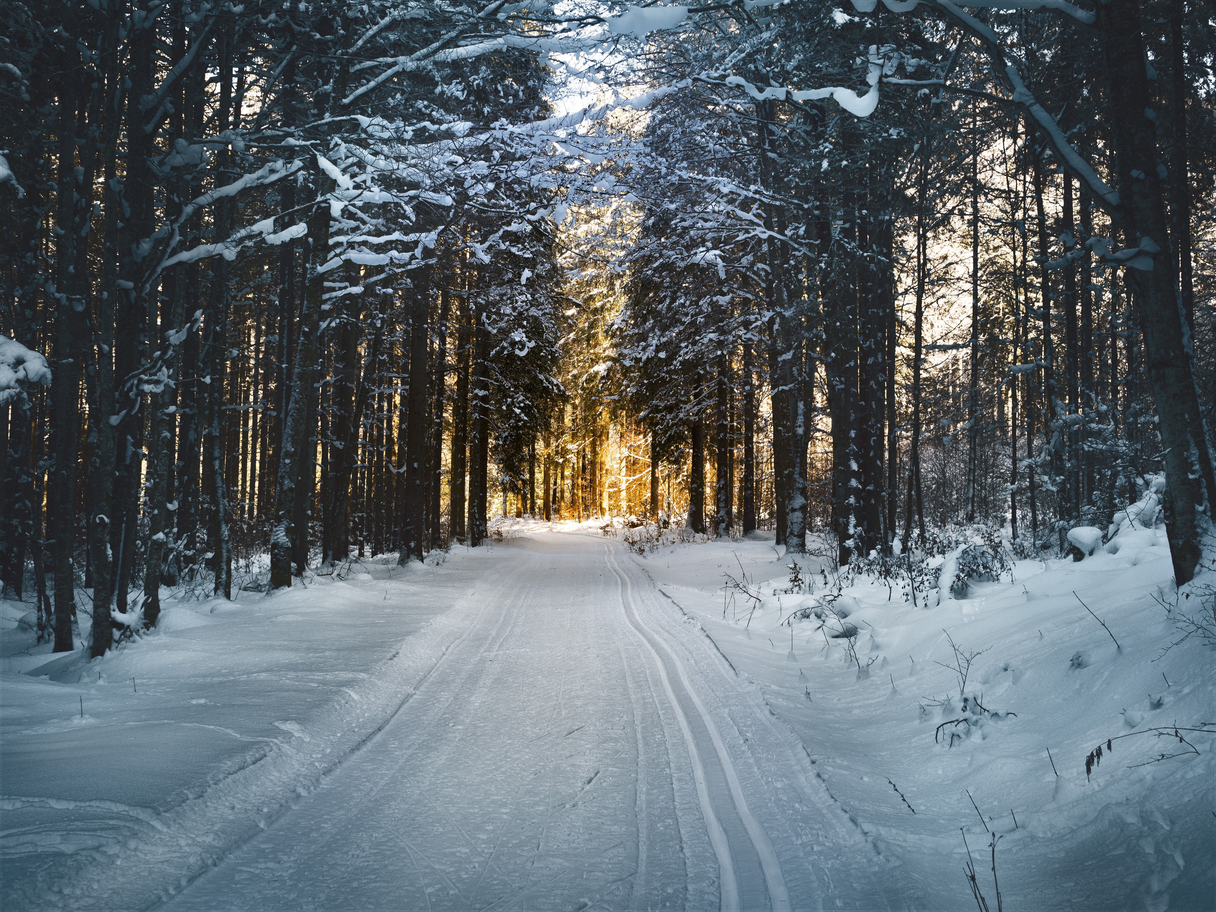

Q&A
“Safe and environmentally responsible;
that’s a win, win.”
– Property manager

Slide 34

Notes:
Facilitator note – Consider adding your local contact information here. Consider passing out business cards with your contact information.

Slide 35
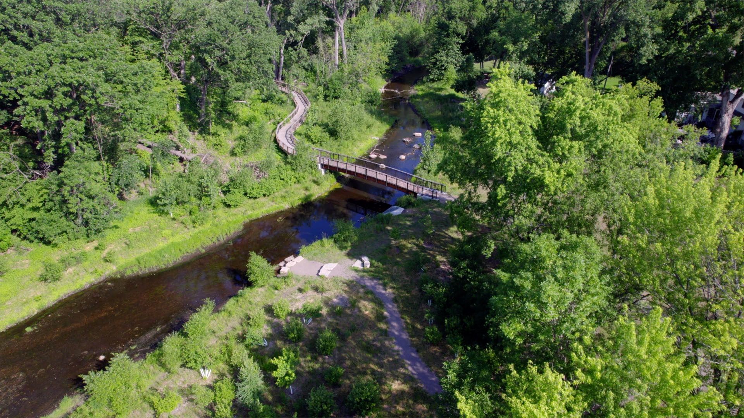
Clearing a path to safety, savings, and sustainability.
Notes:
Facilitator Note - To hide a slide, right click on the slide in the table of contents and select ‘Hide Slide’. Follow the same steps to ‘unhide’.
These are bonus slides that fit the theme that you may use or not use as you wish.

Slide 36
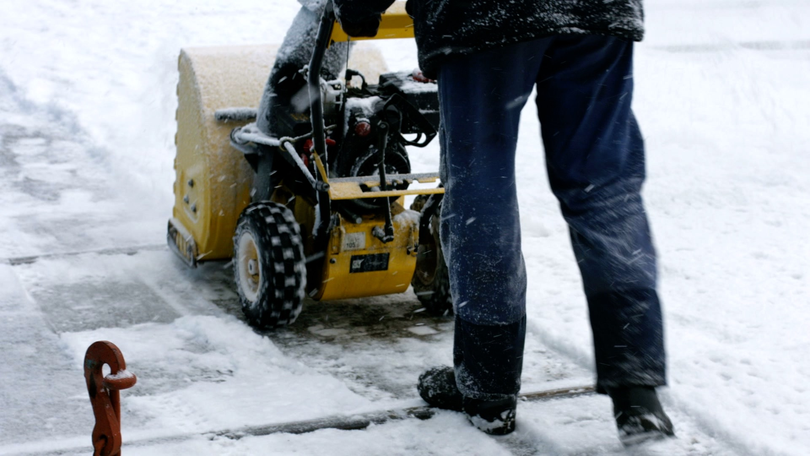
Notes:
Facilitator Note - To hide a slide, right click on the slide in the table of contents and select ‘Hide Slide’. Follow the same steps to ‘unhide’.
These are bonus slides that fit the theme that you may use or not use as you wish.

